Slide 1

The Globetrotters
Trotter the Interactive Levitating Globe
Week in Review: ___________________________________

Slide 2
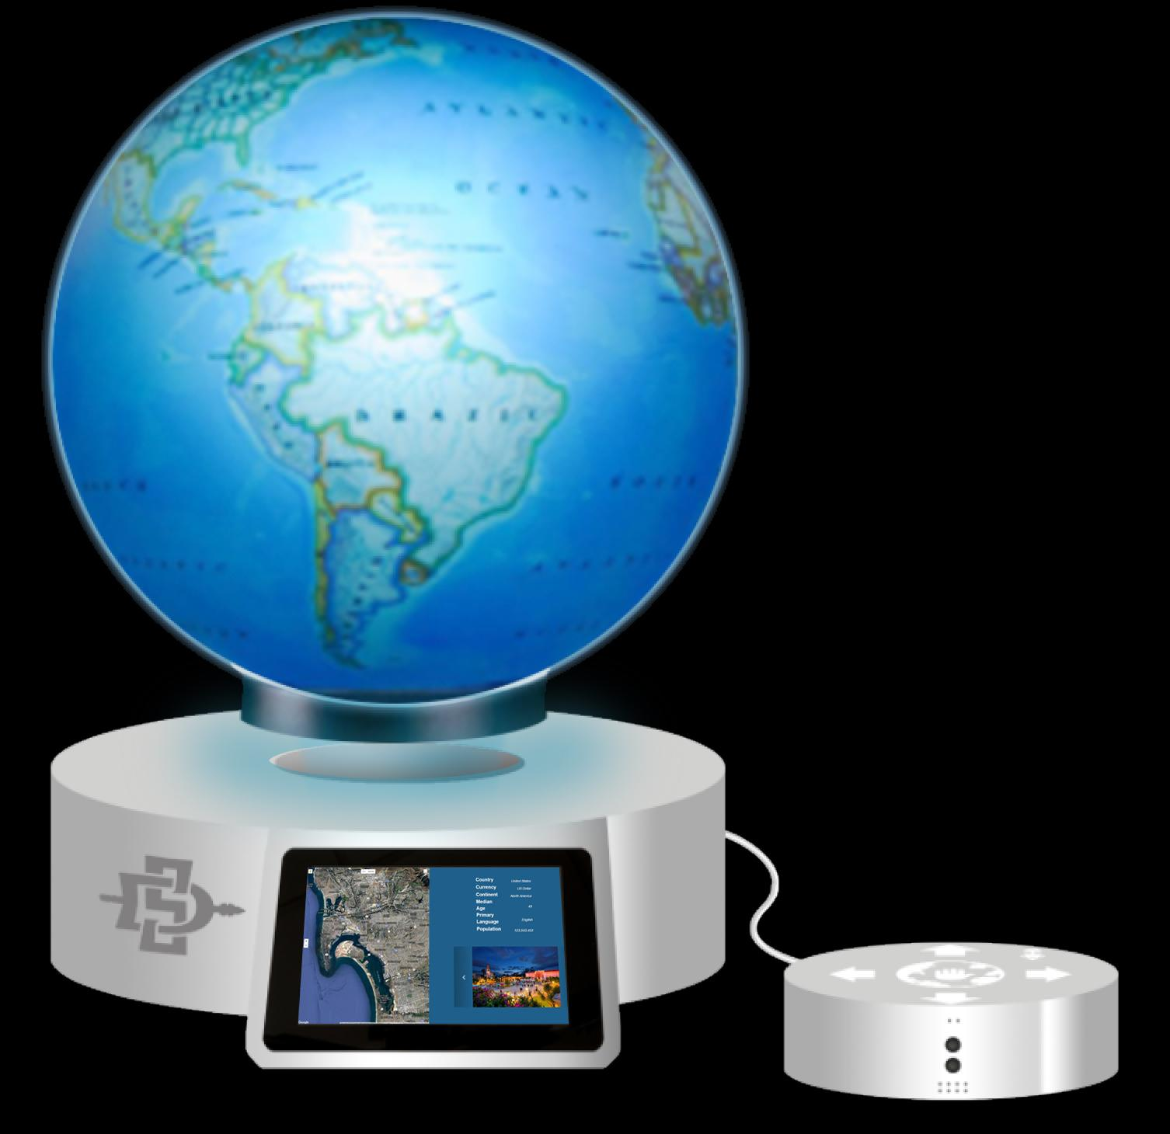
Hello.
Notes:
intro: Hello, thank you all for being here today. My name is Trotter. I am a levitating, voice and gesture controlled, interactive globe. During the presentation my creators the Globetrotters, will tell you all about what makes me so unique. Let’s get started.

Slide 3
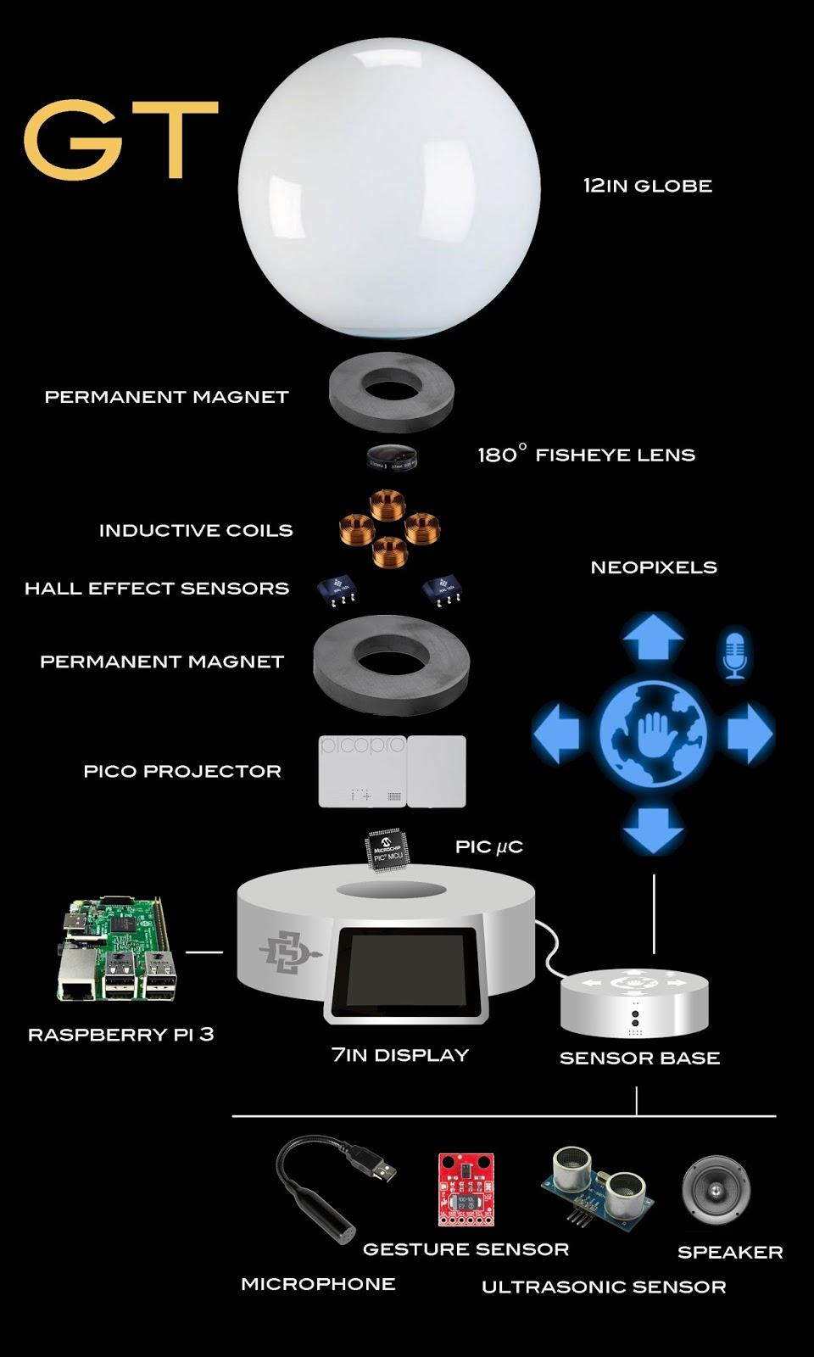

Slide 4
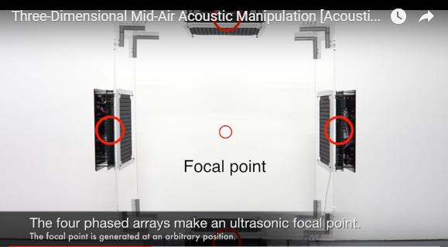
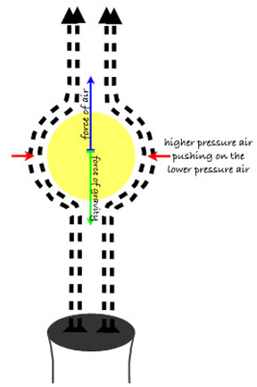
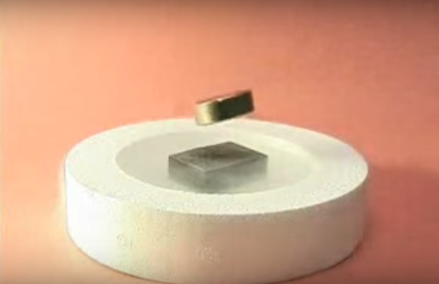
Why Not Another Method?
Superconductors
Liquid nitrogen
Expensive over time
Air
Loud
Unstable
Sound
Great control/stability
Supports little weight

Slide 5
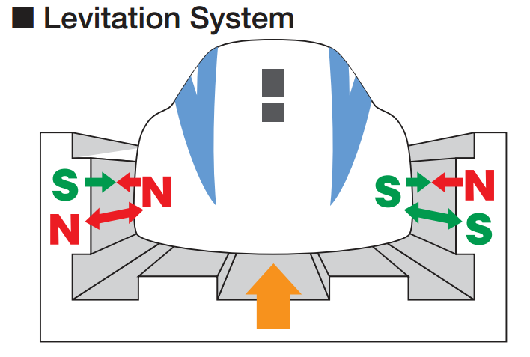
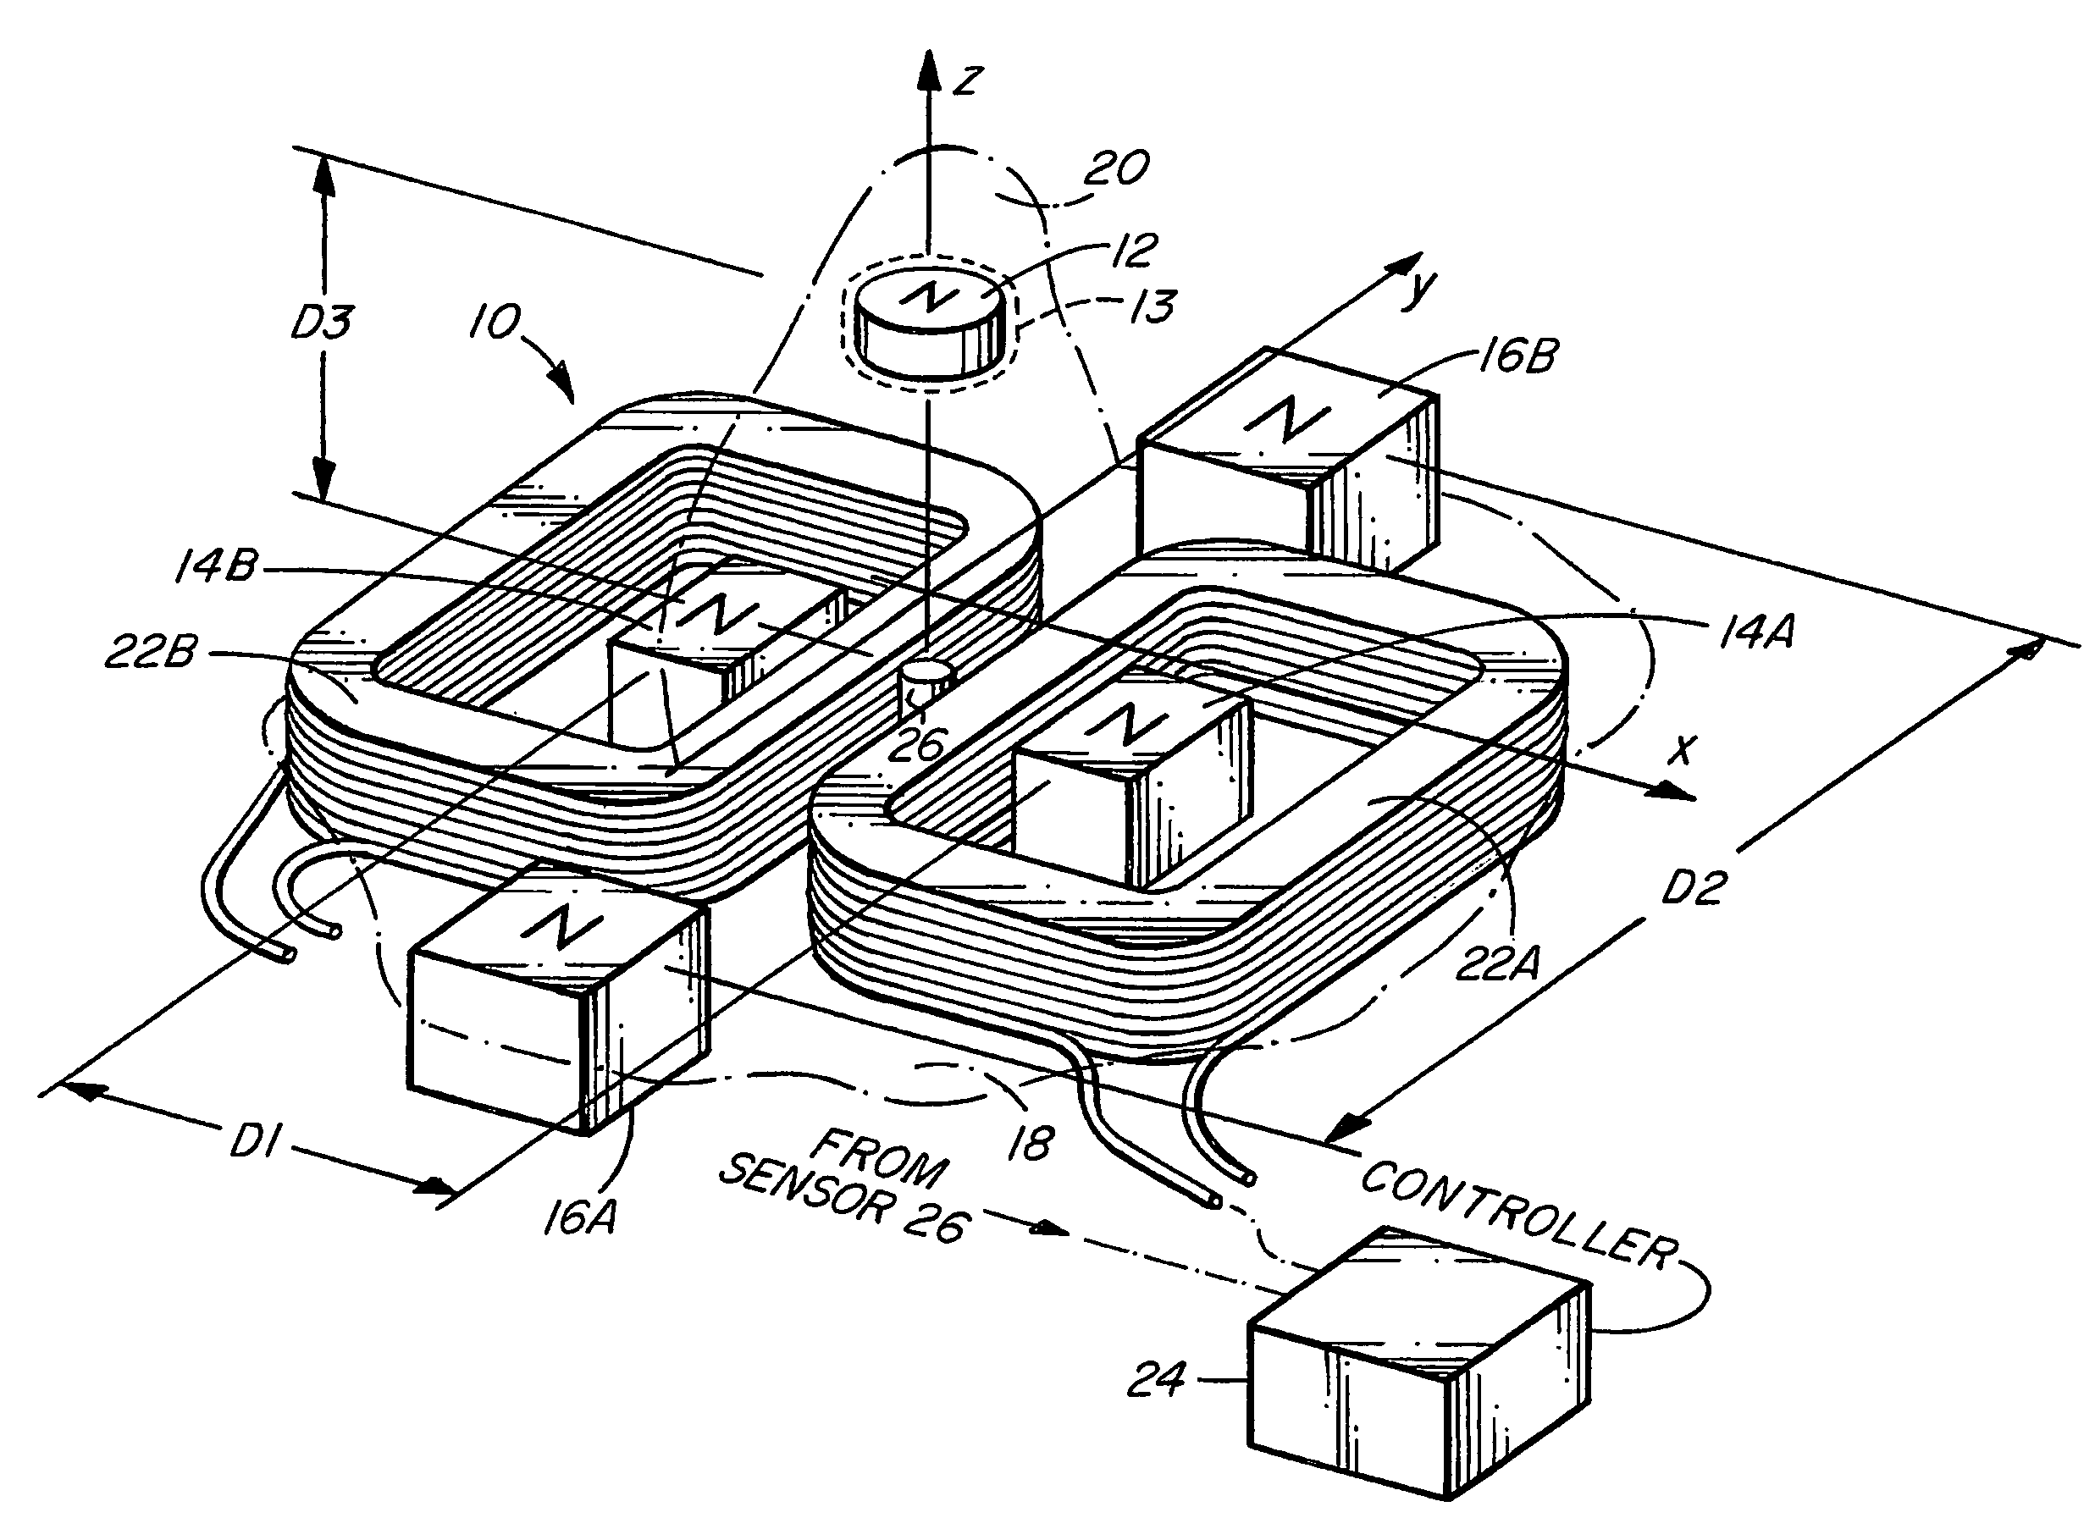
Electromagnetism, black magic?
Magnetic Levitation Theory
Existing uses of magnetism
Maglev Trains
Earnshaw’s Theorem
Position of an object Control system
Monitored using sensors
Coils are paired, strength of magnet varied
Notes:
Same design has been used for years
Feedback: If you can detect the position of an object in space and feed it into a control system that can vary the strength of electromagnets that are acting on the object, it is not difficult to keep it levitated. You just have to program the system to weaken the strength of the magnet whenever the object approaches it and strengthen when it moves away. You could even do it with movable permanent magnets. These methods violate the assumption of Earnshaw's theorem that the magnets are fixed.

Slide 6
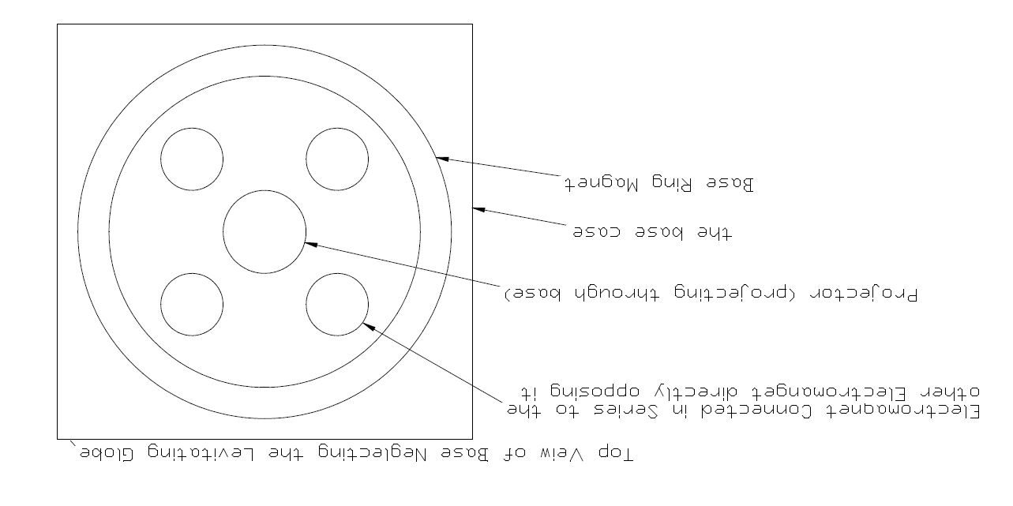
Top View of Base Neglecting the Levitating Globe

Slide 7
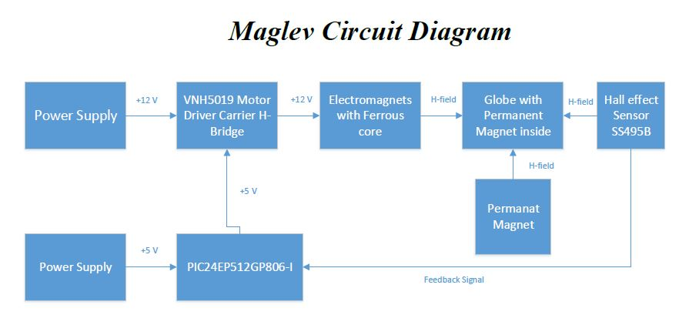
Magnetic Levitation - Implementation & Circuits
Notes:
-Power supply will be a UL-Listed 12V/ 6A
-VNH5019 H-Bridge will allow for push/pull force acting on opposite ends of the magnet. Controlled by PWM signals from out STM 32F0 Discovery board
-custom wound Electromagnets Turns (3200) 28 AWG
-Permanant Magnet
-Hall Effect Sensor SS495B with a sensitivity of 3.125 mV per Gauss
-STM discovery Board
-Fully Integrated H-Bridge motor driver (PWM operation up to 20 khz), (charge pump for reverse polarity)

Slide 8
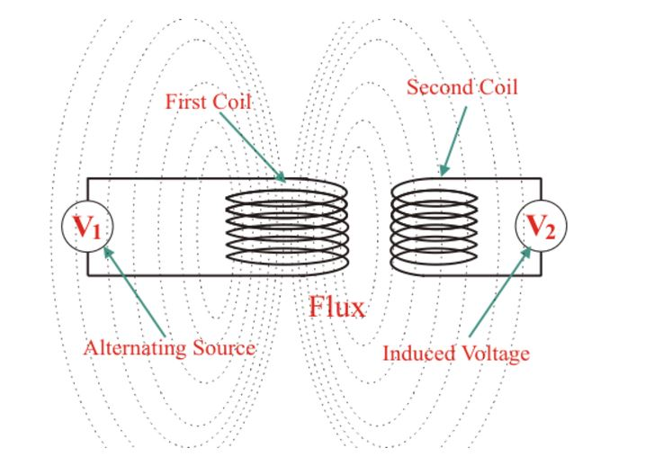
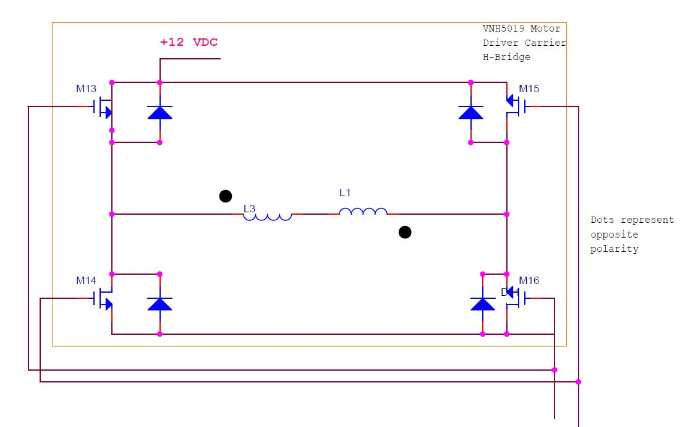
Electromagnets
Similar to Air Core Transformers
The Implemented H-Bridge

Slide 9
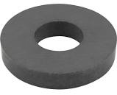
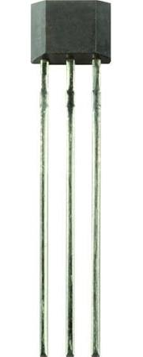
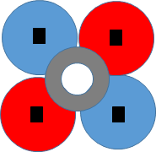
Magnetic Levitation - Control System
Large permanent magnet (repulsion force vs. distance)
4 electromagnetic inductors
Hall Effect Sensors
SS495B (bipolar, linear)
As the magnet moves towards 1, current flows into electromagnets 1 and 4 pushing back towards ZPP
1
2
3
4

Slide 10
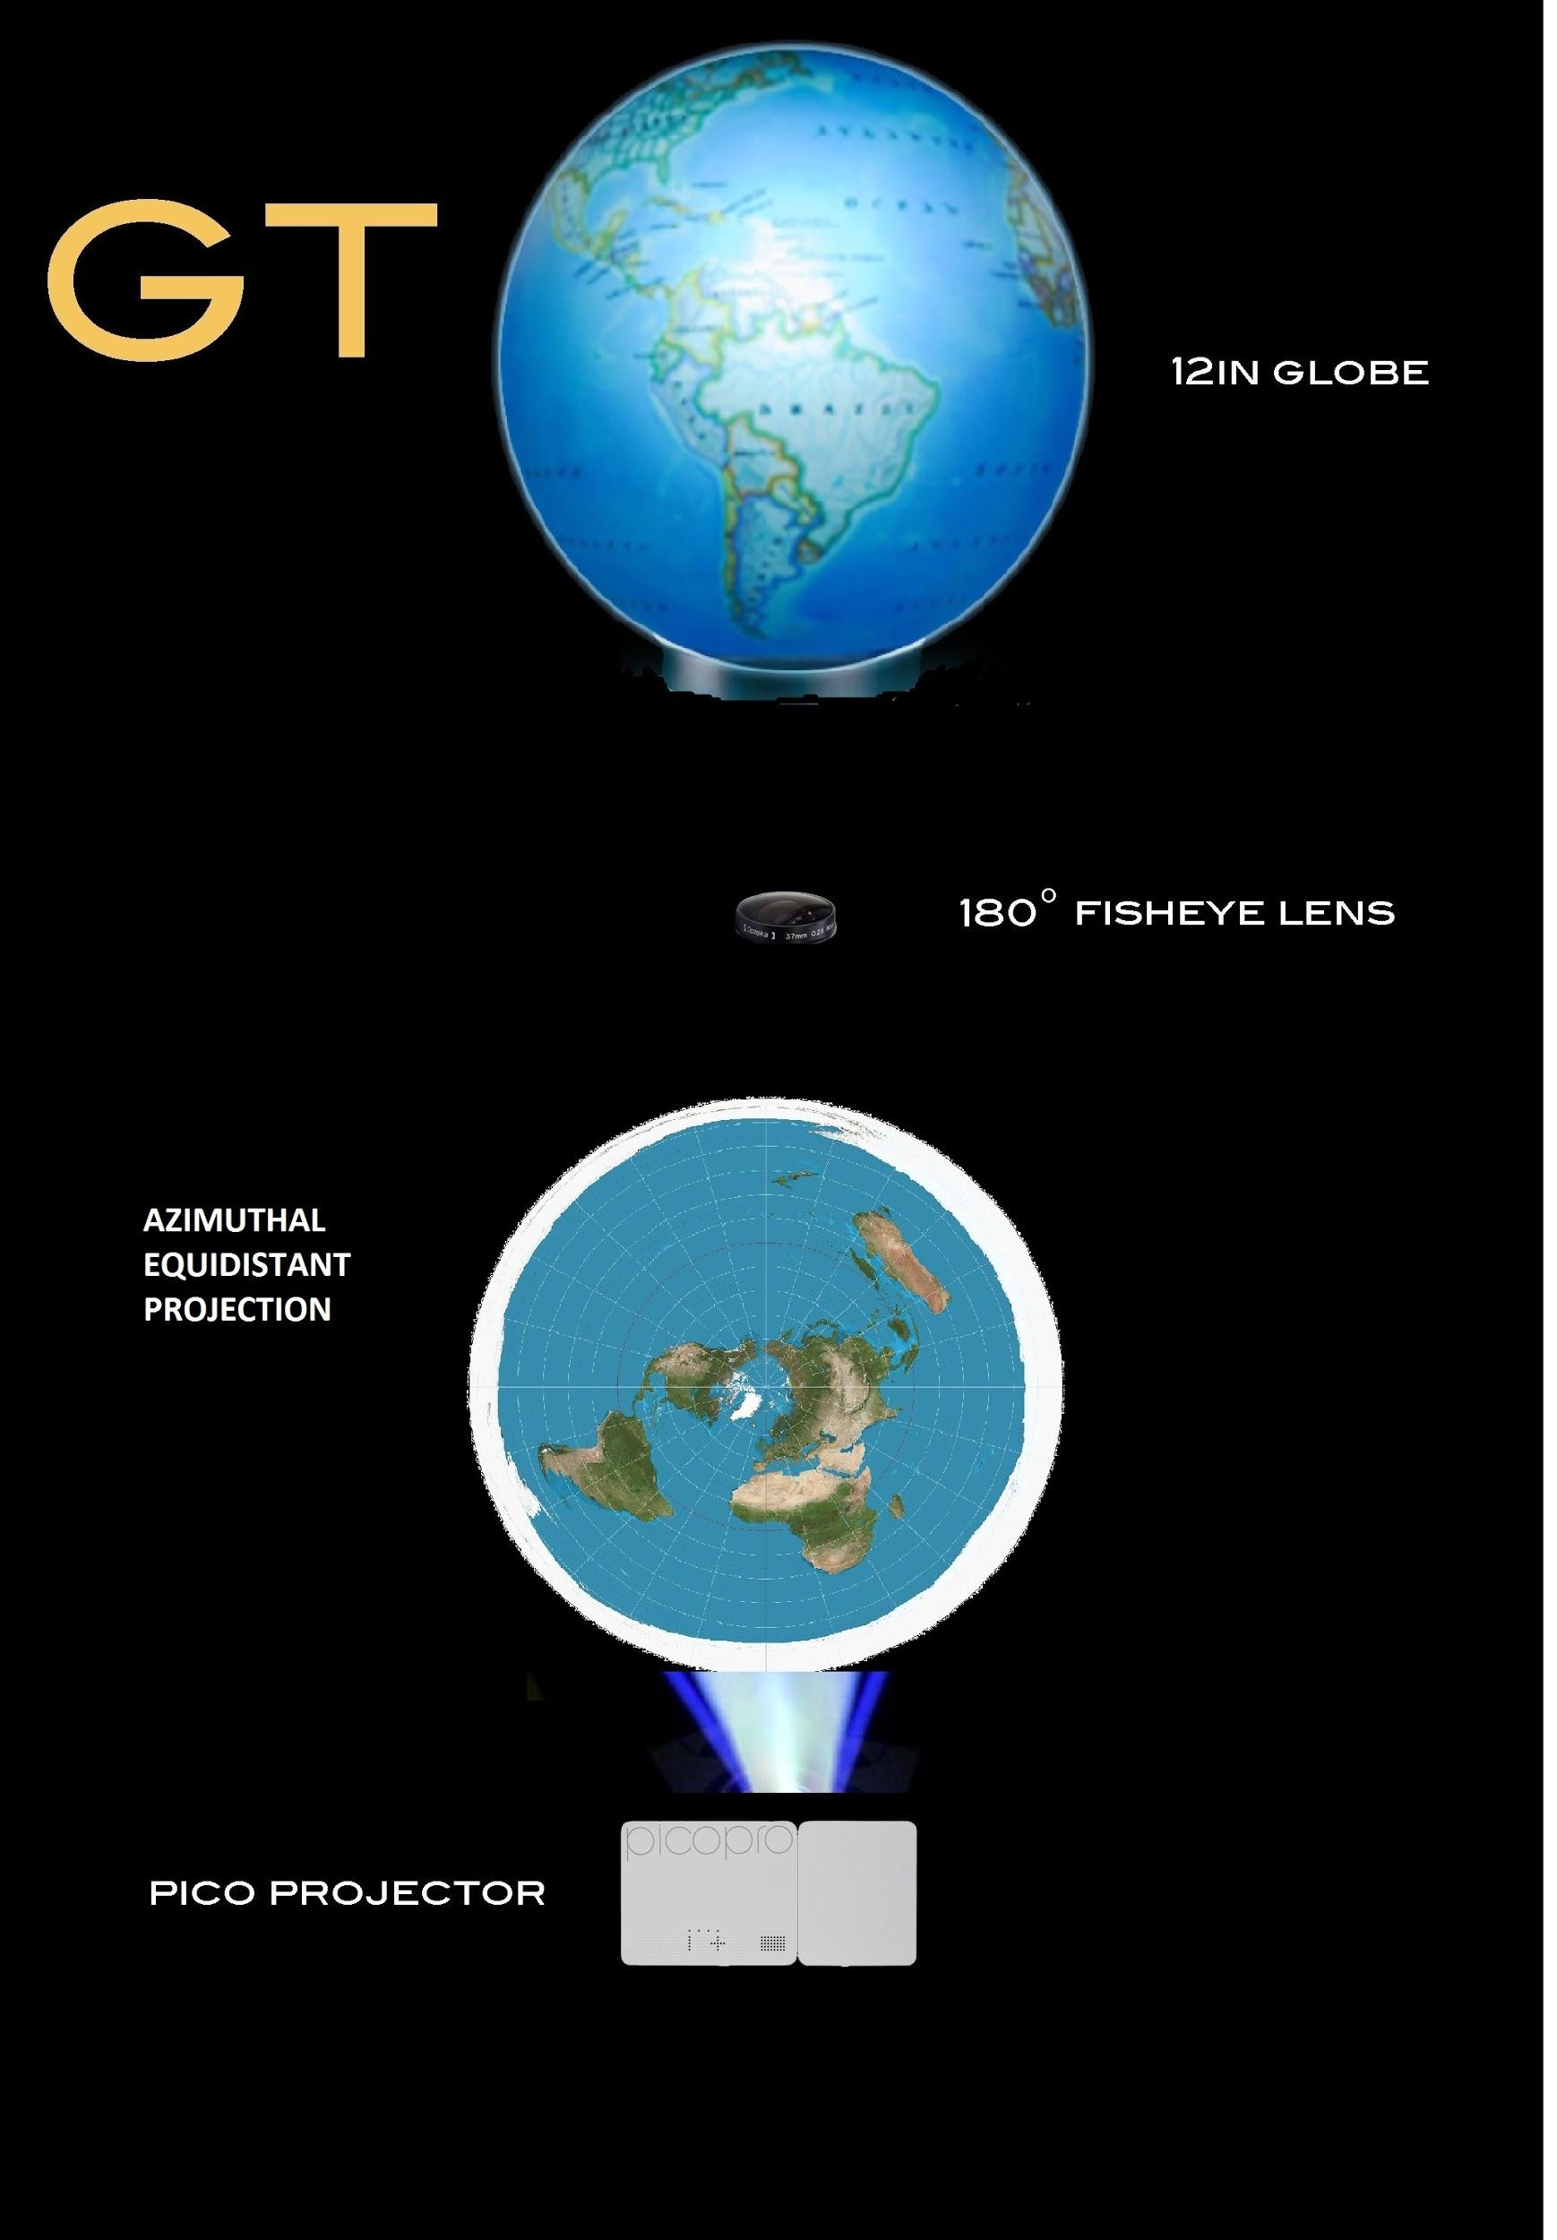
Projection & Rotation
Rotation
Implemented using Python
Controlled through RPi
Voice commands and gesture control
Projection

Slide 11
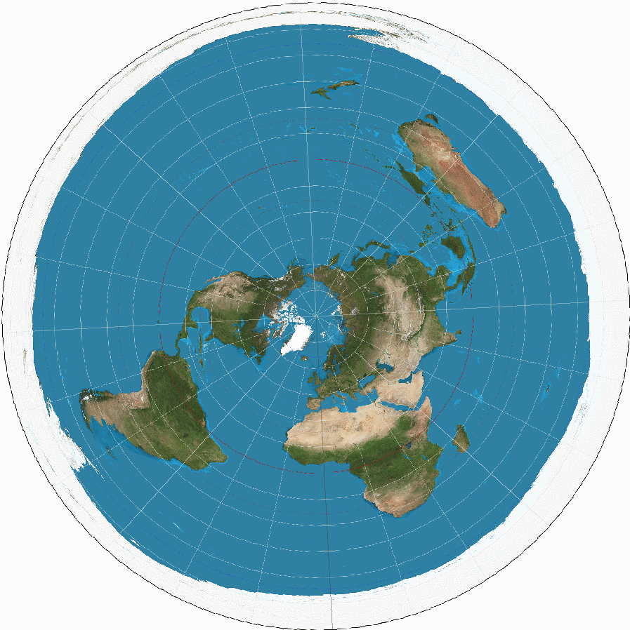
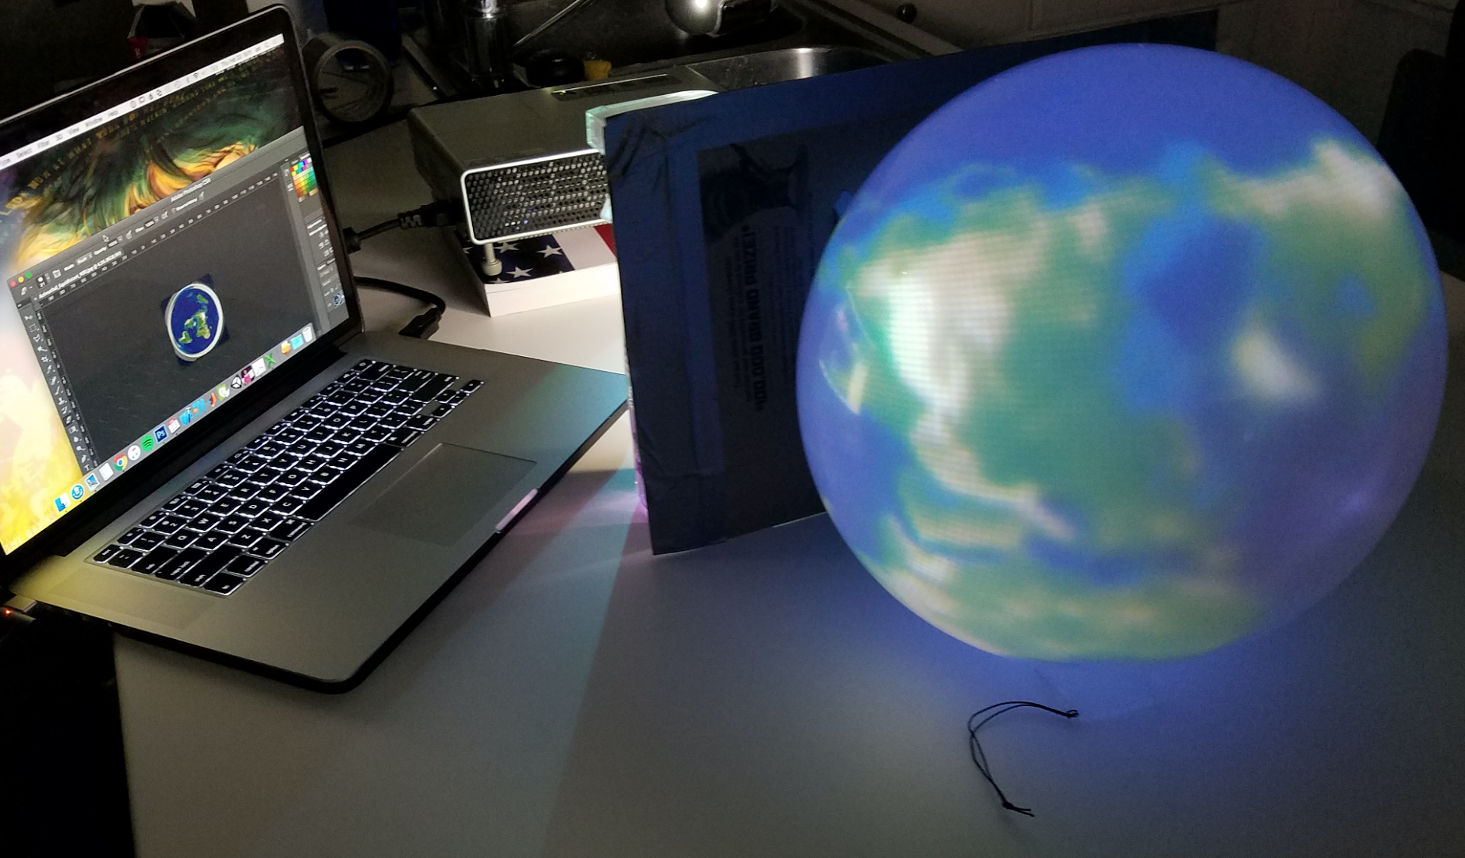
Projection & Rotation

Slide 12
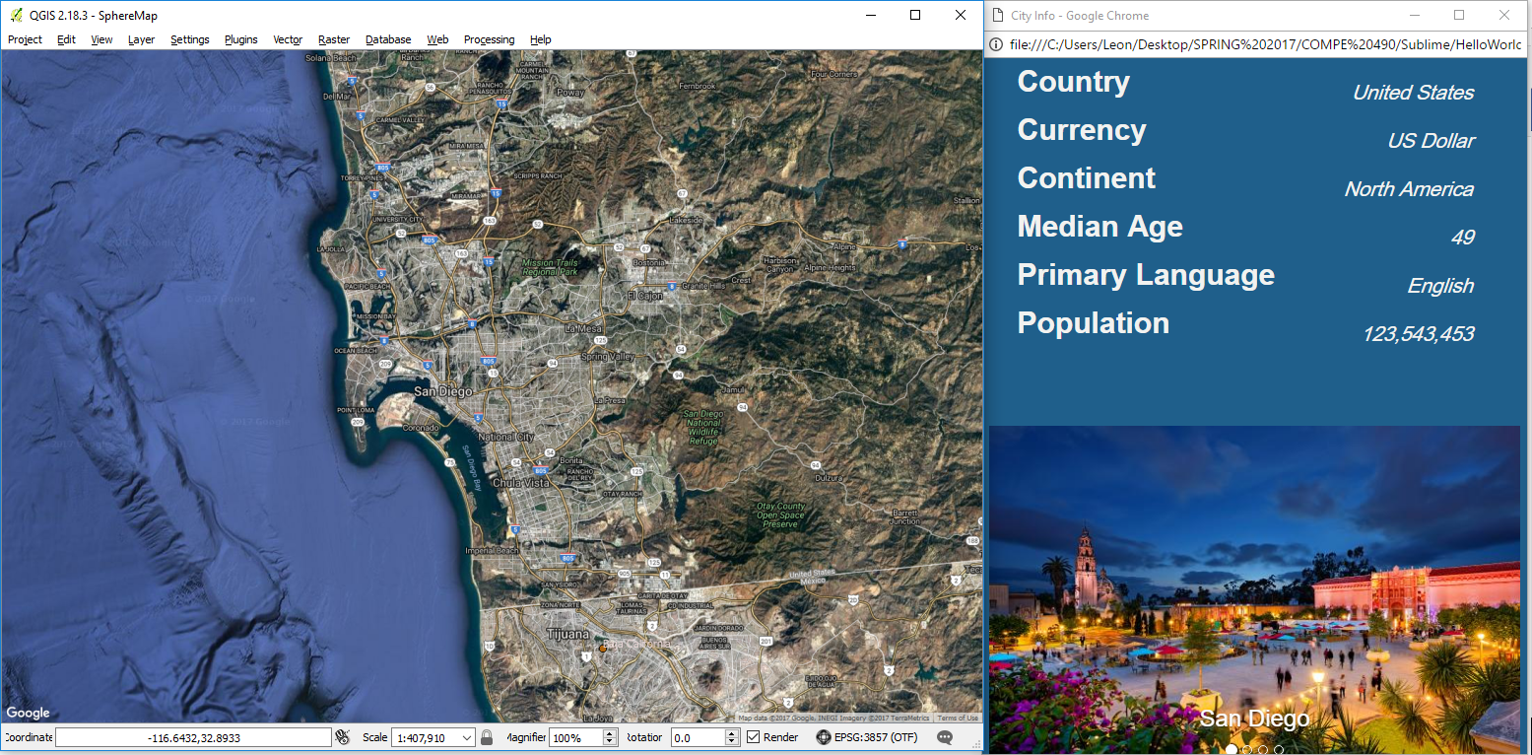
Quantum Geographical Information System + GUI
Notes:
Regarding the GUI part of our project, the goal is to provide a user-friendly presentation of specific location information as it is requested
We would like to include a dynamic map that will change on demand and show much greater detail about the requested location than may be visible on the levitating globe, and we would be using the QGIS application to do this (describe what is QGIS briefly: create, view, edit, and analyze maps and related data)
Details about the requested location, including the country, population, and other facts as well as a set of related images will be shown alongside the map on a local web interface, built using HTML and JavaScript
The entire GUI will be a self-controlled interface based on the user’s location requests. For instance, if somebody wants to know information about a city, the map will relocate its view window to that city using longitude and latitude coordinates, and the web interface will refresh to reflect new information about that city
We’ll be testing the interface to determine a viable screen size to fit all the information on, but we’re thinking something between a 7 and 10 inch display

Slide 13
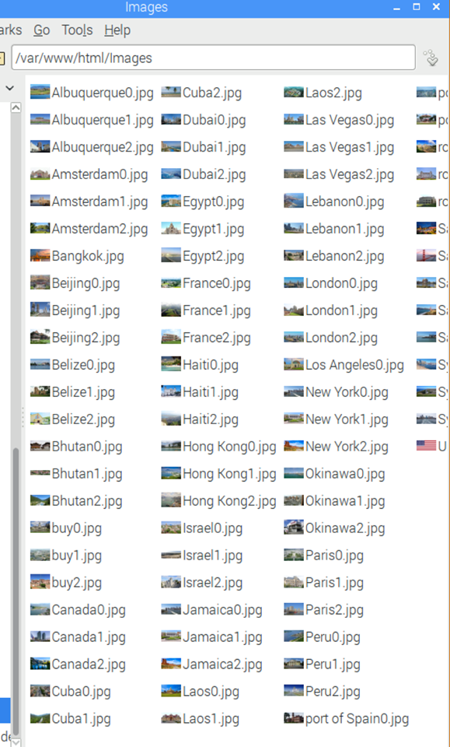
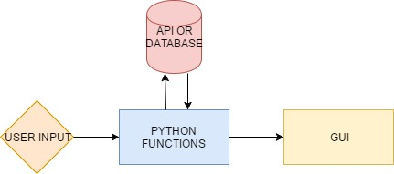
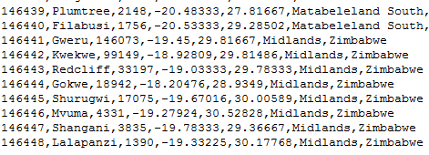
Databases + APIs
Retrieve and store information
APIs
Google Places - images based on coords
Teleport API - general information and stats
Python functions to query MySQL database, values used by GUI

Slide 14
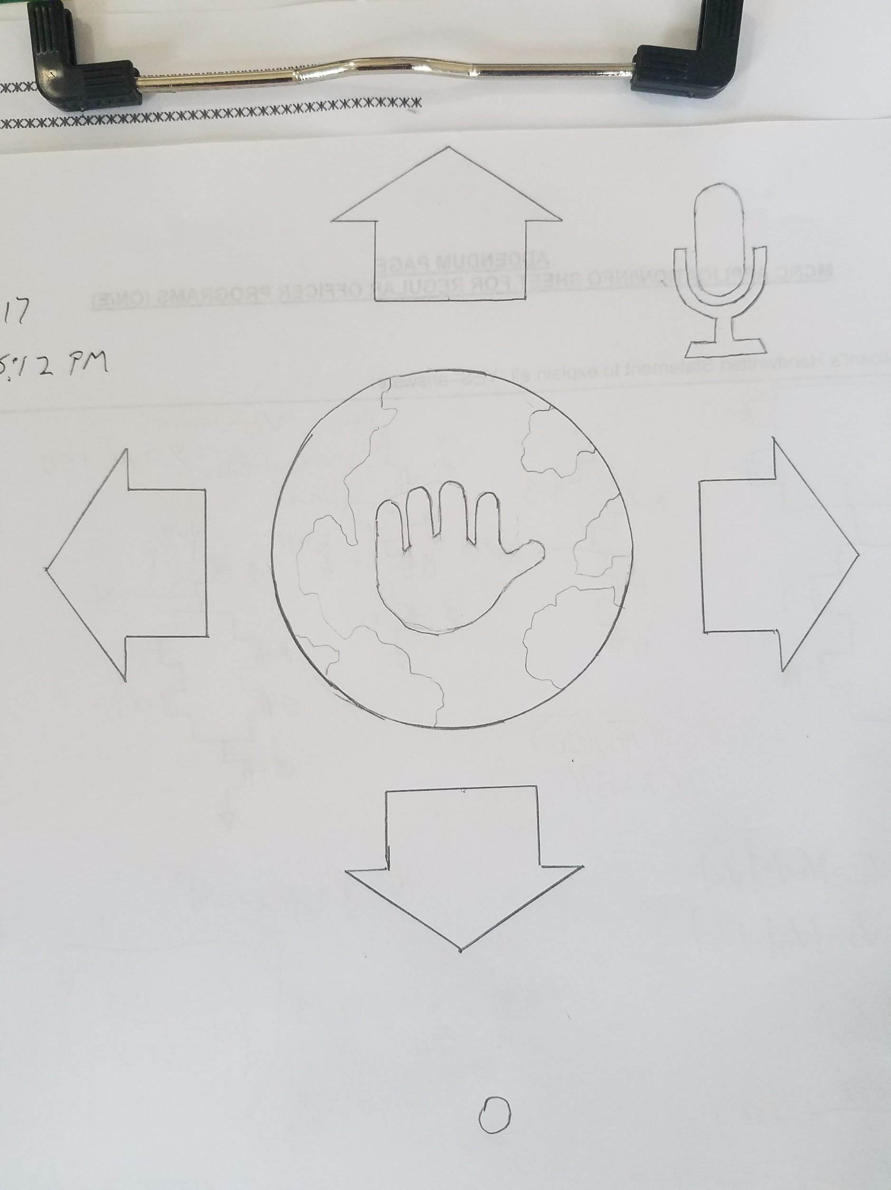
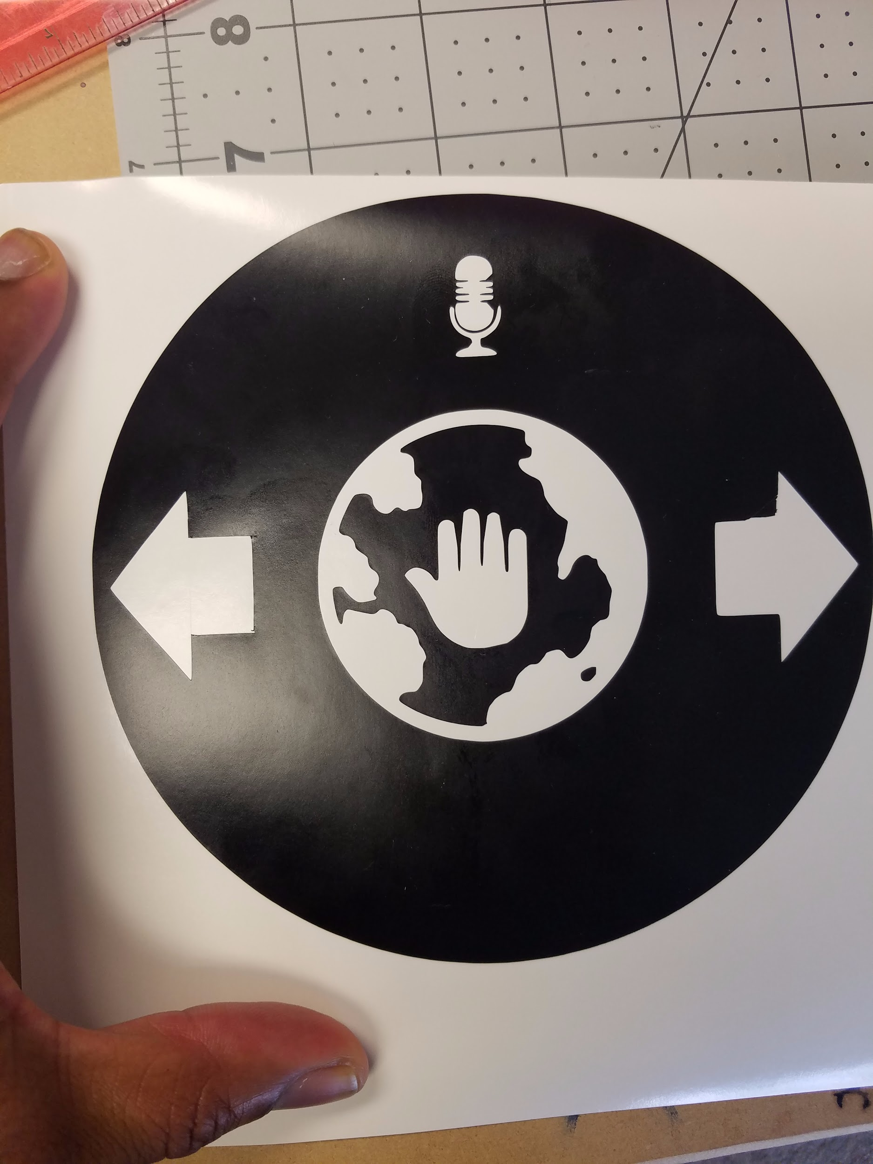
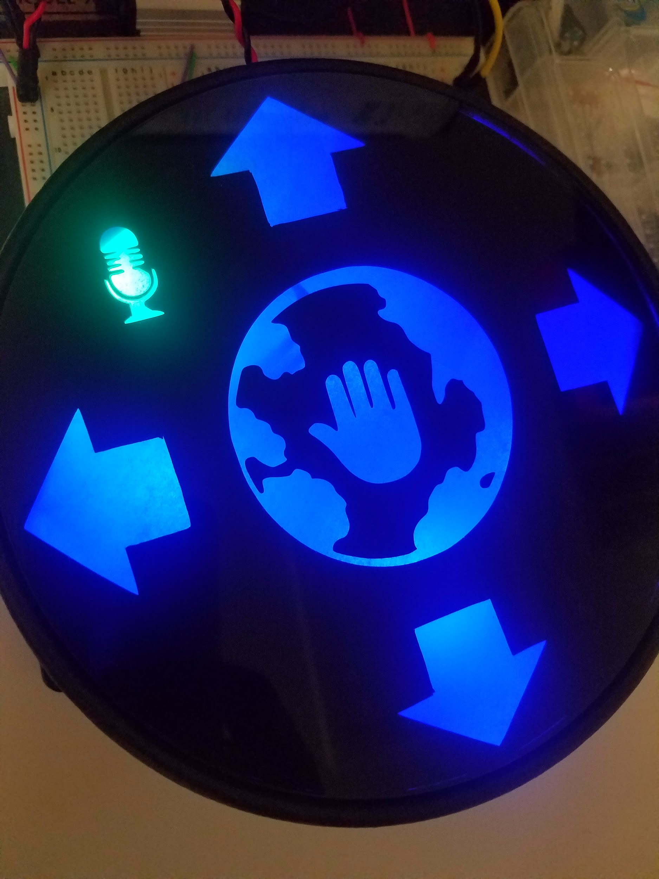
Gesture Recognition - User Interface
Notes:
- We designed a gesture interface that would be intuitive to use with minimal instructions.
- the interface is designed to provide feedback to the user when they engage a gesture control.
- For example if they hover their hand over the left arrow it will change color to indicate that the globe is rotates west.

Slide 15
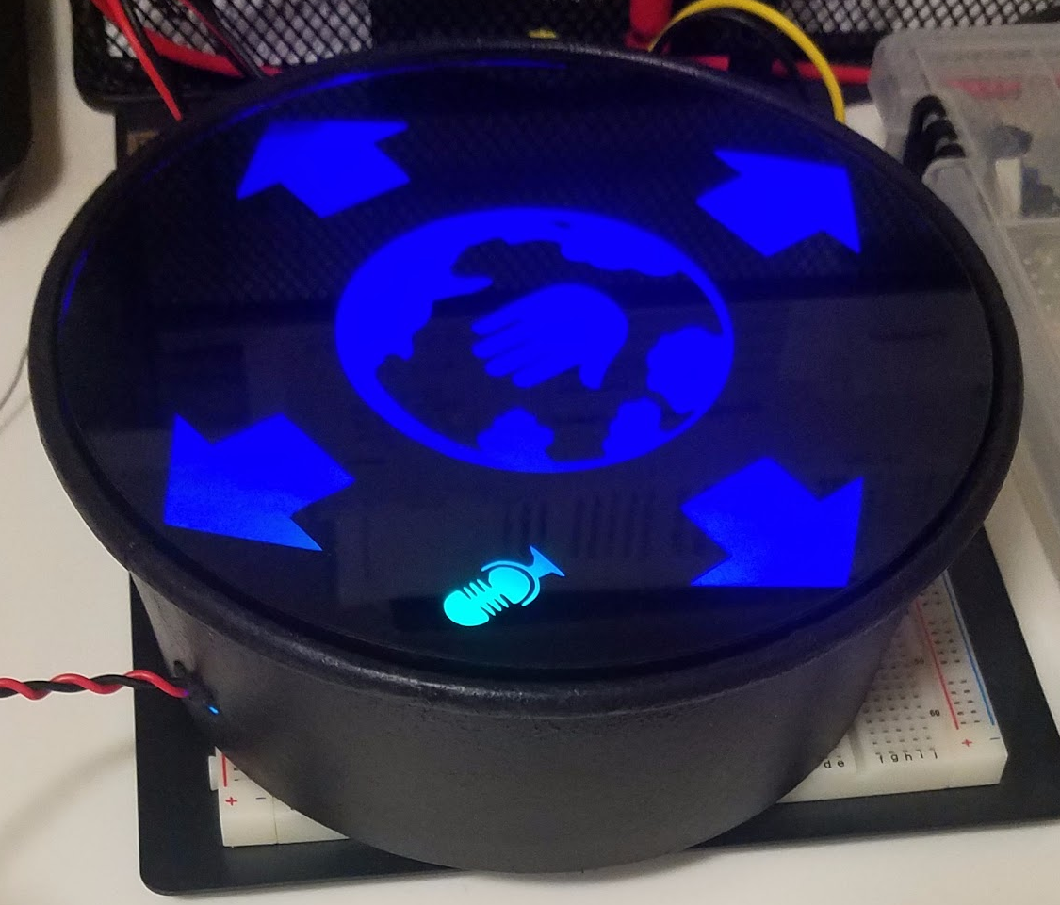
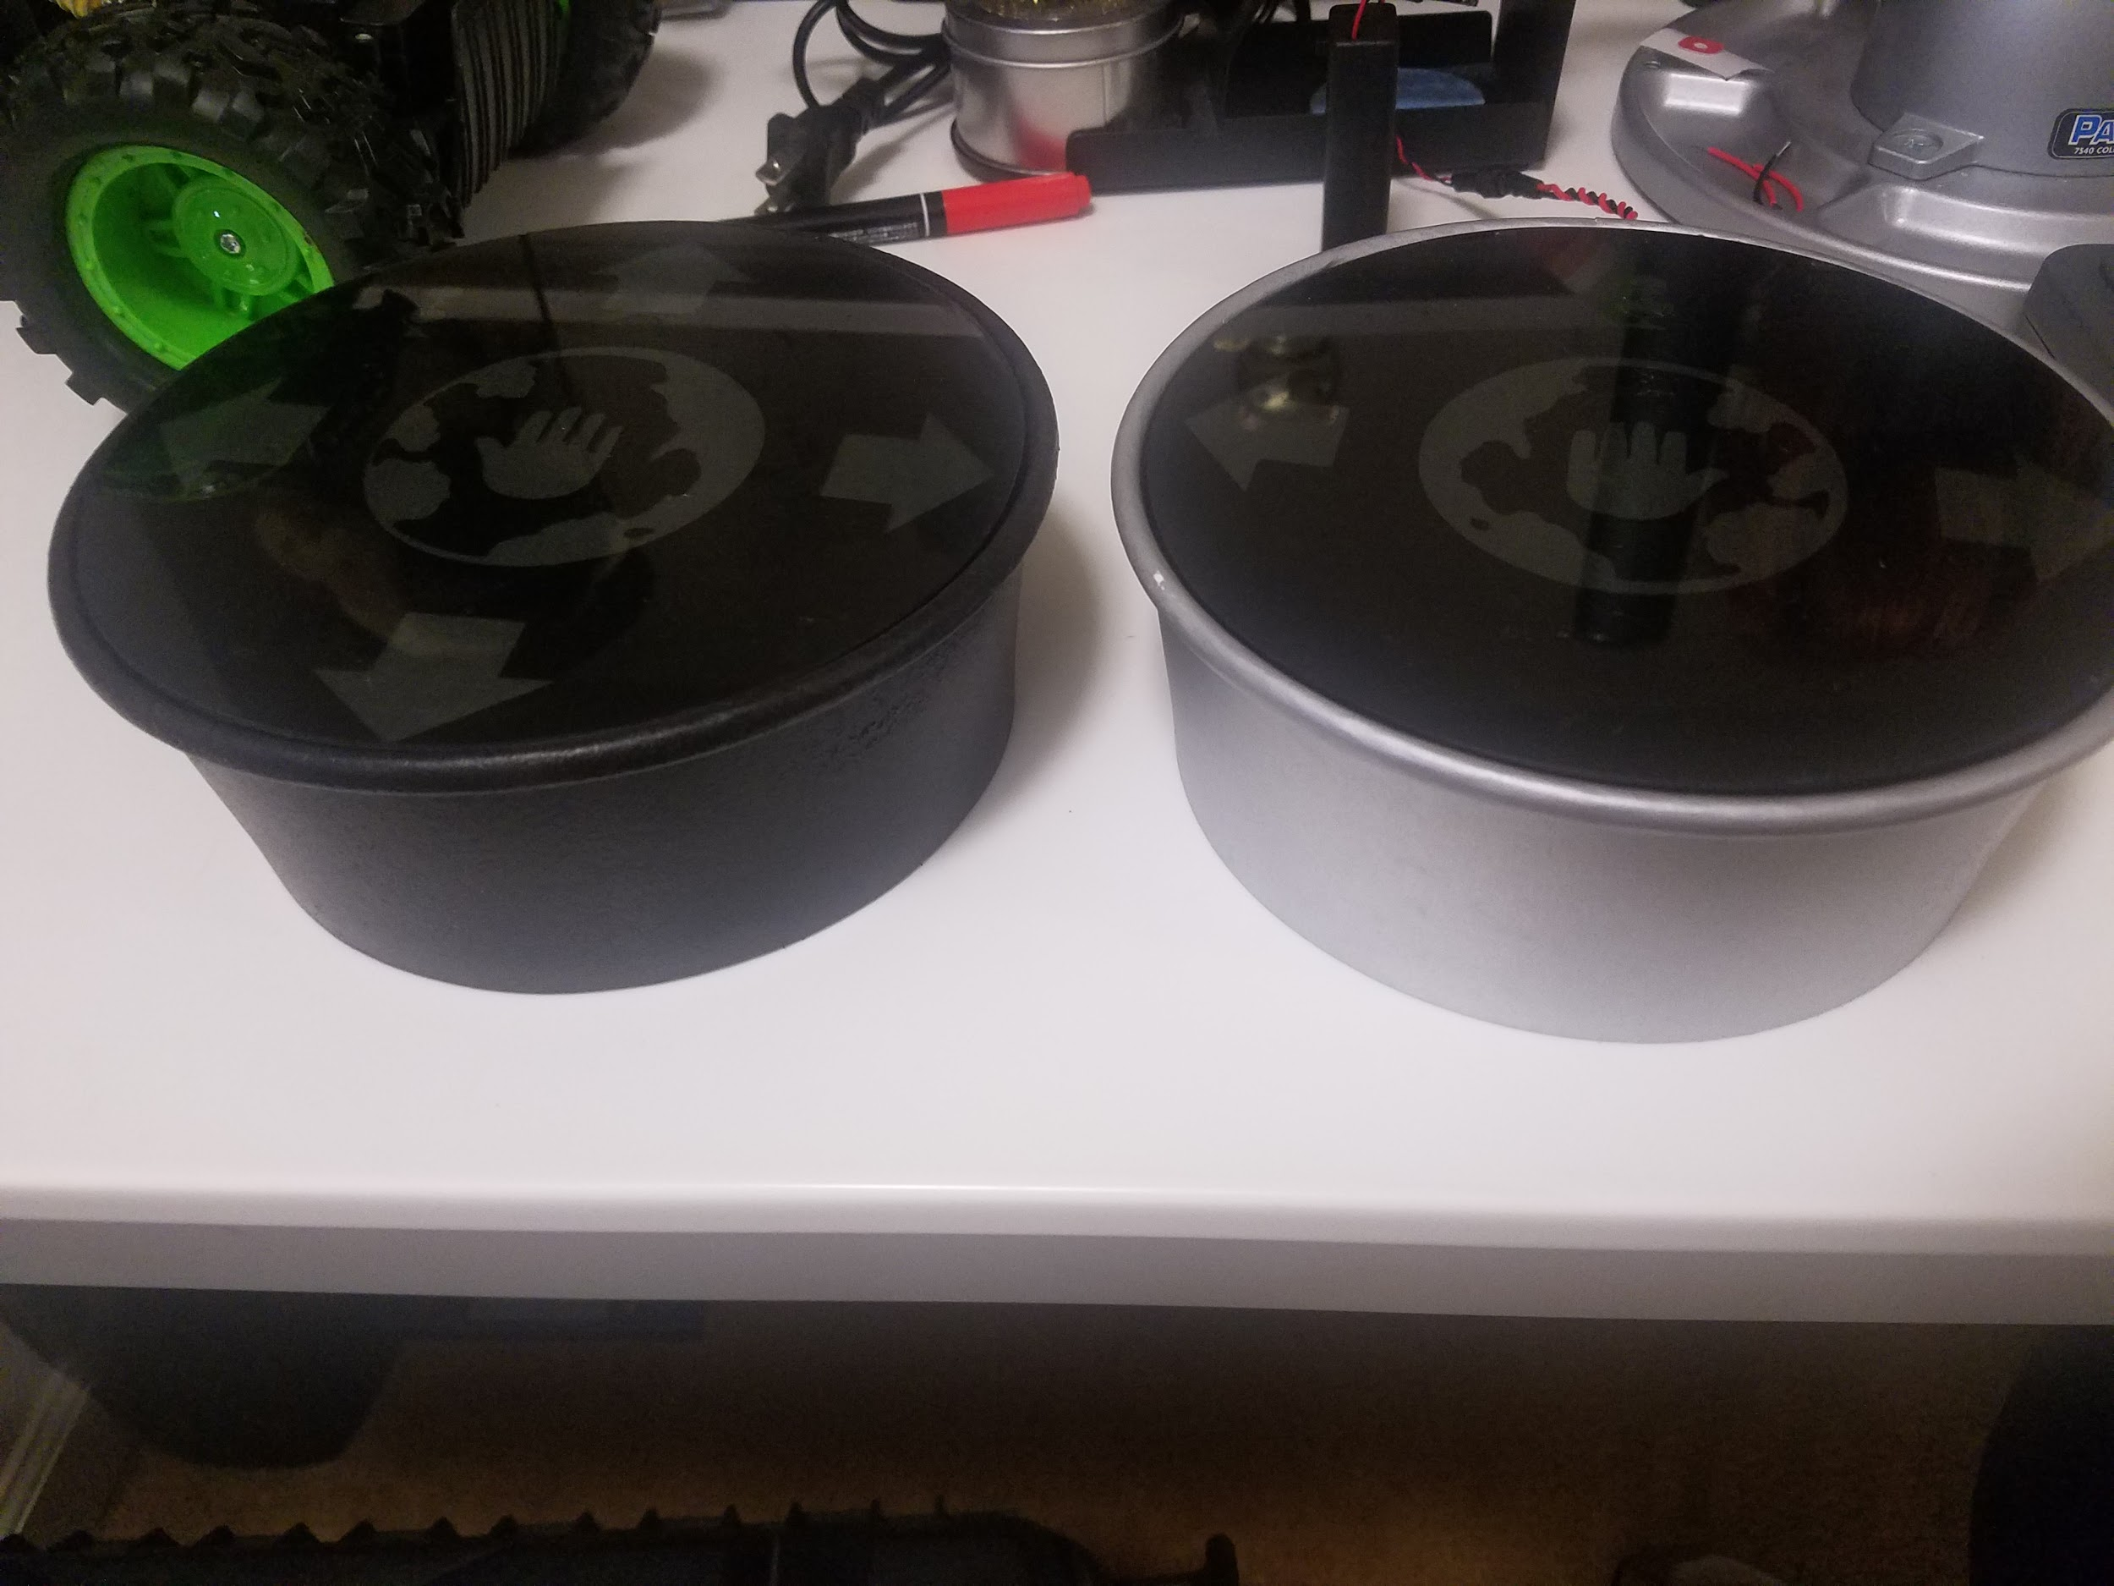
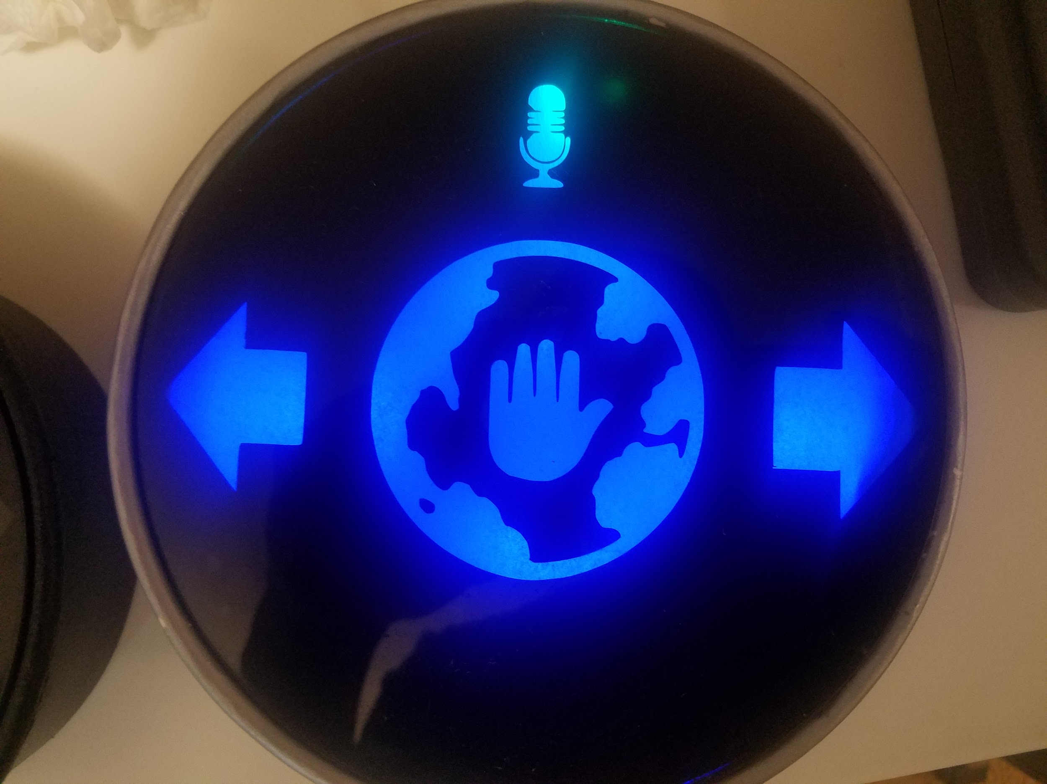
Gesture Recognition - Prototypes
Notes:
- These are prototypes of the gesture interface that we built.

Slide 16
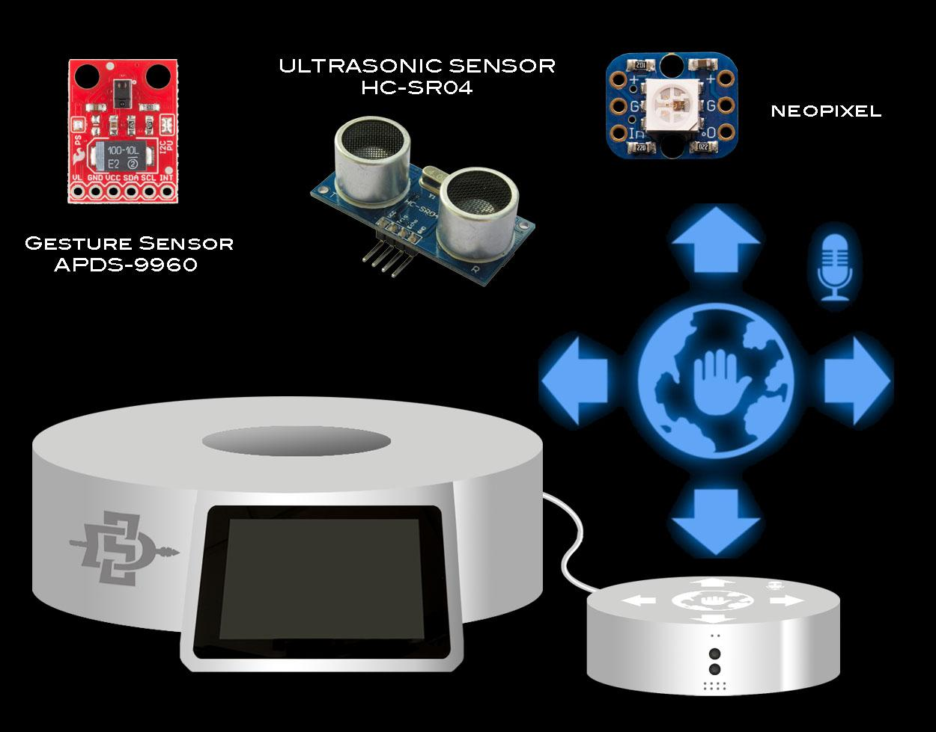
Gesture
Recognition
Components
Notes:
- These are the components specific to the gesture interface.
- the gesture sensor, ultrasound sensor and neopixels are located inside the gesture controller on the right.
- the gesture sensor can detect swipes in 4 directions and proximity with 4 - 8 inches
- the Ultrasonic Ranging Module can detect objects within 1 - 157 inches (2cm - 400cm).
- It will be used to detect if a user is st of the device.

Slide 17
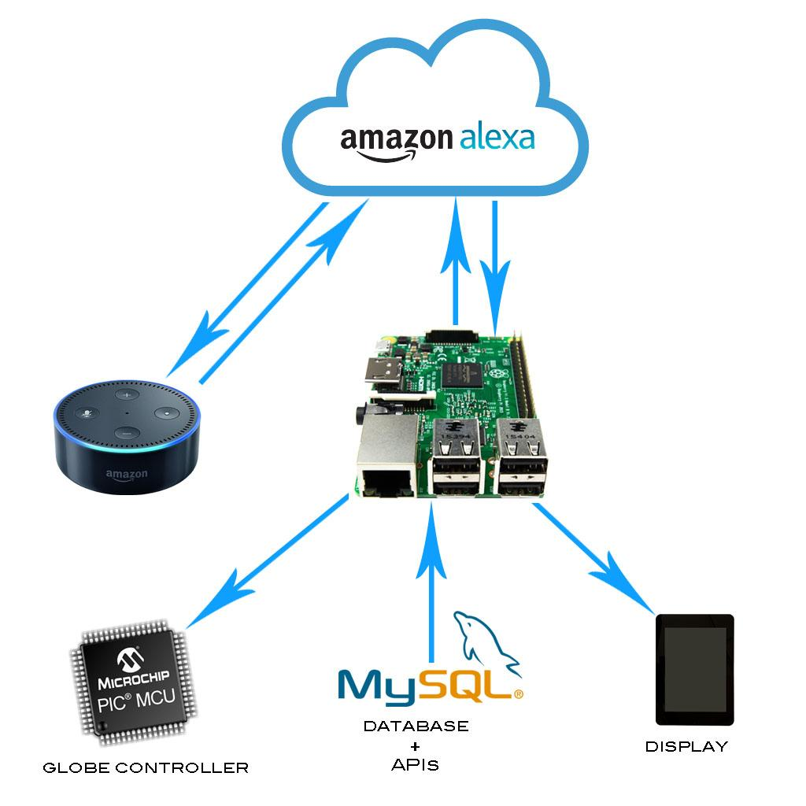

Voice Recognition
Notes:
- Here is a simple breakdown of how the voice interface is implemented.
- First the user speaks their command for trotter.
- The command is streamed from the Dot to the Alexa Voice Service in the cloud for Natural Language Processing.
- The Alexa skills interface then extracts any variables from the speech and calls the appropriate function on the Raspberry Pi.
- The Pi then uses the database to generate a verbal response that is sent back to the Dot.
- The Pi also generates control and display signals for the globe and GUI.

Slide 18
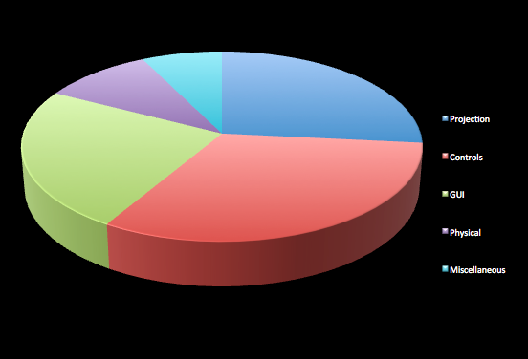
Budget -
Cost Analysis
$1500
7.4%
10.0%
26.5%
24.1%
32.0%

Slide 19
Milestones
Voice & API 3/16/17
GUI & Integrating API Data 3/22/17
Levitate an Object 3/24/17
Levitate the Globe 4/07/17
Complete all software Integration 4/13/17
Levitate the Projected Globe 4/28/17

Slide 20


Sponsors

Slide 21

Conclusions
Notes:
Trotter: Thanks again for coming today. You have been an awesome audience, I mean that from the bottom of my microchip! . I would like to extend a special thank you to our sponsor, Morris Cerullo World Evangelism. Now that you have heard all about me, I would really appreciate your feedback. Does anyone not named Andy have any questions?

